Slide 1
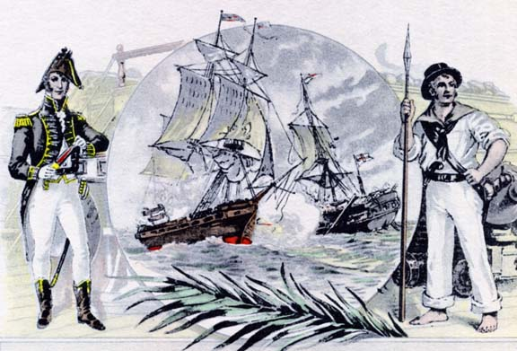
Chapter 12 https://www.youtube.com/watch?v=50_iRIcxsz0&safe=active
Madison and the Second War for Independence

Slide 2
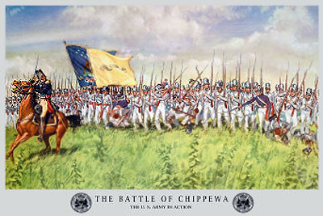
HOW NOT TO START A WAR/Intro
-Worst fought war
No national anger
Minority led by war hawks
Disunity
Unprepared
Suffering from embargo and non intercourse act
Bank of US expired
Army ill trained and small
Old generals

Slide 3
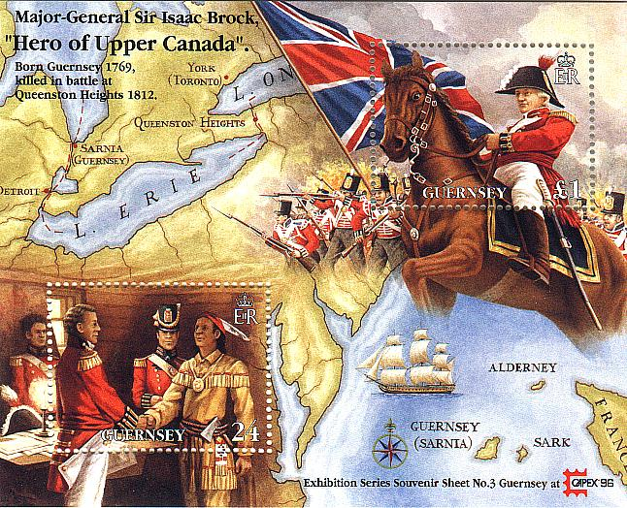
On to Canada
Failed invasion of Canada
Not a bad plan. British weak in Canada. Badly devised invasion
Should have taken Montreal, but decided on three prong attack
Defeated at Detroit, Niagra, and Lake Champlain

Slide 4
Read the document
Annotate for main ideas in the right column
Put a tweet at the end of each paragraph that summarizes main idea. (How could he get his message across in a tweet?)
Answer questions

Slide 5
Read for meaning and connections
A:Who has he come for?
B. How are the US and Canada the same?
C: What does he promise the Canadians?
D. What will this war turn in to if the Canadians do not help the US according to Hull?
Final Question: Why would a proclamation like this bring fear to the Federalists?

Slide 6
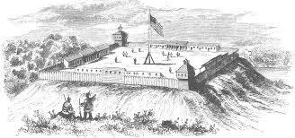
British have more energy and better plan at beginning
-Brits captured Fort Michilimackinac
-British general Brock (Brits)
vs. Mud and Confusion
-US Needed a victory
Looked to water

Slide 7
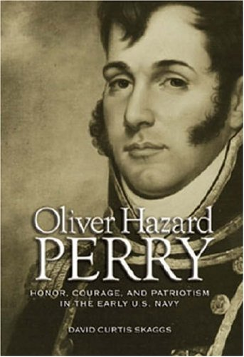
Victory at Sea and On Land
USS Constitution. Old ironsides. Used better in battle
Needed to control Great Lakes
Oliver Hazard Perry: controlled Lakes
Won at Put in Bay
“We have met the enemy and they are ours”—MORALE BOOSTER
Privateers: major weapon against Brits

Slide 8
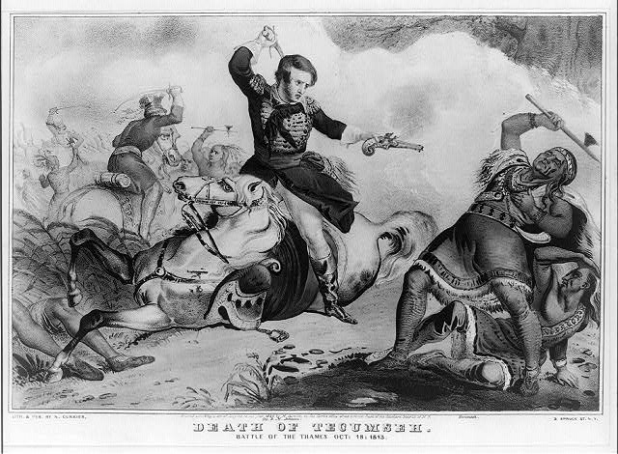
-1813, Harrison won at Battle of Thames
-Things looking good for us
-Then Napoleon defeated, and British starting to head to Canada to fight US

Slide 9
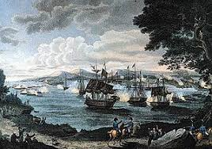
British made mistake
Wanted to attack NY
Had to get supplies over Lake Champlain, no roads

Slide 10
US navy led by Macdonough challenged Brits
-Won by attaching cables to his ship to turn it!
-Saved NY

Slide 11
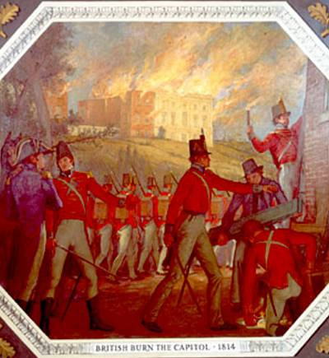
DC burned, NO Defended
British came up from Chesapeake in 1814
Bladensburg races: US retreating
Pres had to flee
Dolly saved paintings

Slide 12
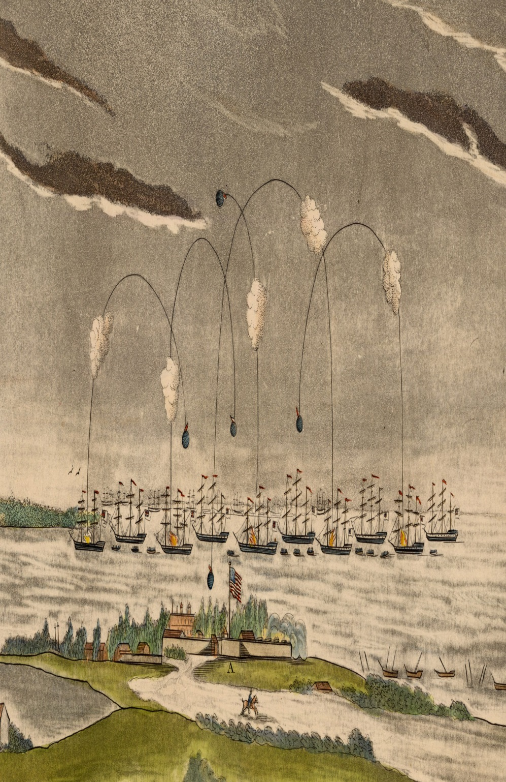
Fort McHenry was next, but did not fall
Then the Brits went for NO
-Jackson fighting Natives in S
Battle of Horseshoe bend crushed native resistance in S

Slide 13
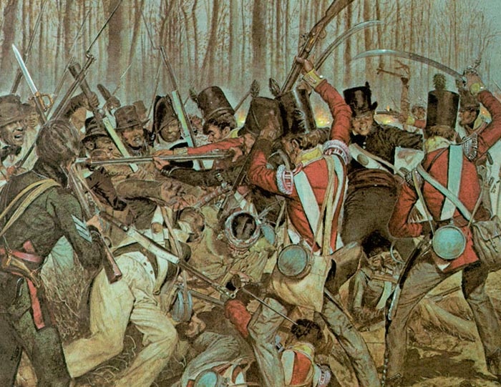
New Orleans
Jackson had a force of all types of people including free Af/Am
British tried to come from head on, not good

Slide 14
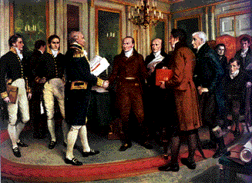
Treaty of Ghent
Czar Alexander I steps in
Needs business to make up for Napoleon losses
Talks reached stalemate to news of US wins come in

Slide 15
Signed Christmas Eve 1814
Armistice, no mention of what they would get
Not an inch ceded or lost

Slide 16
Annotate the document by summarizing important aspects in the right and left column

Slide 17
In the boxes, label the 7 amendments to the Constitution the Hartford wanted:

Slide 18
Bell
1. What were they asking to be done to the US government?
2. Why do these rules make sense to Federalists?
3. Why are they not taken seriously?

Slide 19
In the boxes, label the 7 amendments to the Constitution the Hartford wanted:

Slide 20
In the boxes, label the 7 amendments to the Constitution the Hartford wanted: | Base vote on population of actual voters | Need 2/3 to come in as a state | No embargos for longer than 60 days
2/3 to become involved in trade with a foreign nations | 2/3 to declare war | Cannot hold government office if naturalized | Cannot serve as president twice or cannot come from a state twice

Slide 21
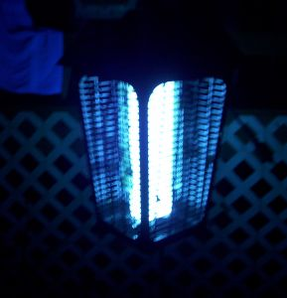
Federalist Grievances
NE defiant throughout war
Most prosperous during war
Trading with Canada
Madison almost lost election in 12
Some NE want secession
Blue Light Feds(gave blockade runners position away)

Slide 22
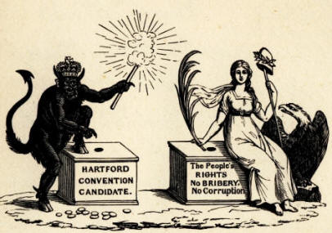
Hartford Convention
Feds meet in Hartford Conn
Met for 3 weeks in secret
Wanted financial assistance from Washington
Most radicals outvoted
Wanted amendments to limit Congress: 2/3 for an embargo to be a go

Slide 23
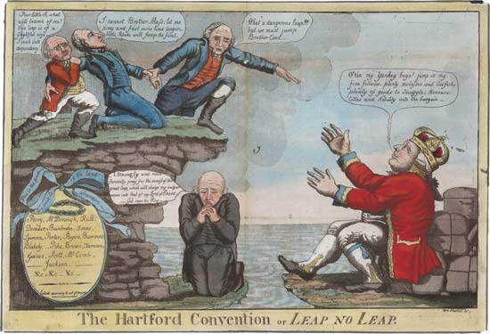
3 envoys sent to Washington
Showed up just as news of NO came
Looked silly
Feds on way out
Treason?

Slide 24
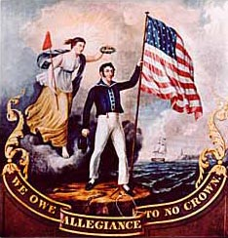
2nd War for Ind?
Small war
6000 US killed
Got street cred
Sectionalism reared its head
Military tradition
Native threat removed
Industry spurred by Blockade

Slide 25
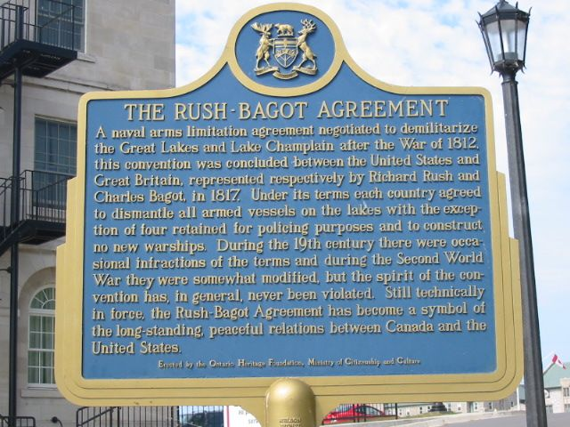
International Legacies
Bitterness towards England
Canada felt a little betrayed
Rush Bagot 1817 led to better relations US/Canada

Slide 26
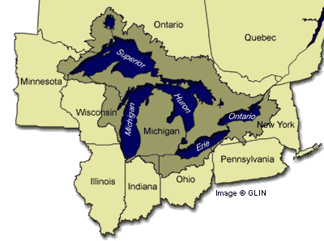
Europe at peace
For US time to move W

Slide 27
Bloody Nose Cartoon
1. What perspective is this cartoon being drawn from?
2. How does this cartoon illustrate the US’ feelings after the war of 1812?
3. How will this war hurt the US too? (at least for a short while?)
4. How will the war help the US?

Slide 28
Nascent Nationalism
Best thing to come out of war of 1812
Came out as 1
Madison more pop on way out then in
Not as dependent on England
Feds die out
Americans first, state second

Slide 29
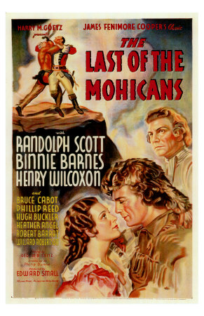
New literature: Cooper and Irving
Textbooks for and by Americans
North American Review: Journal
Painters celebrated American scenes

Slide 30
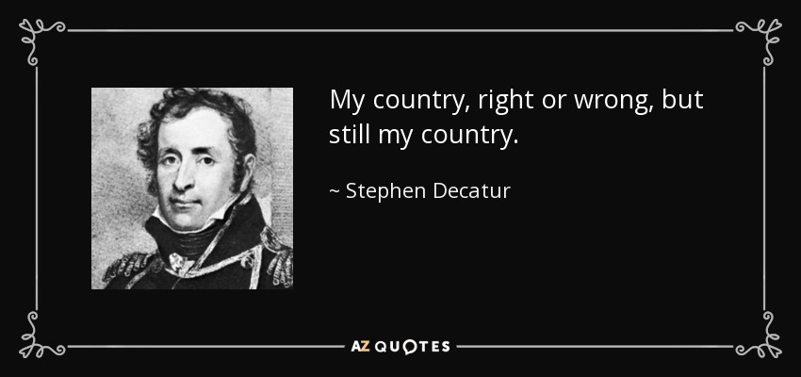
Rebuilt capital
Bigger army and navy
Decatur: Our Country Right or Wrong!

Slide 31
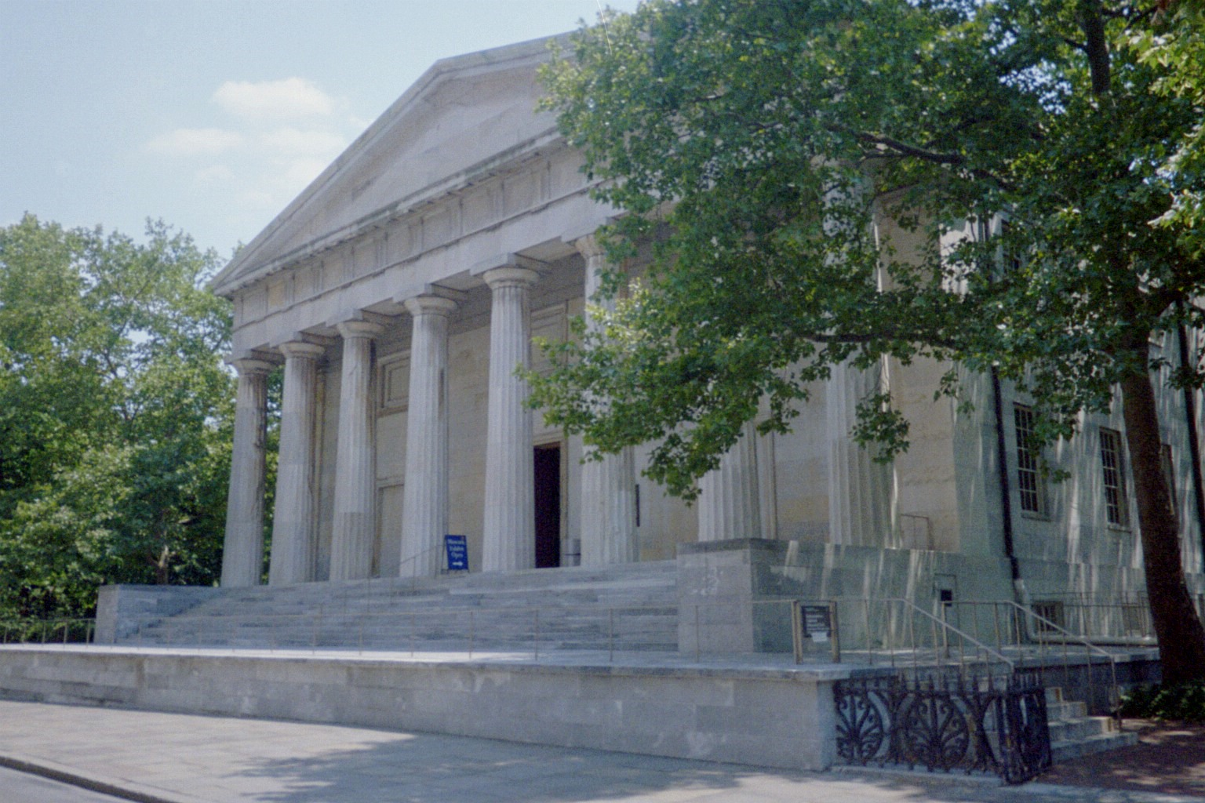
War showed need for bank
Weak state banks had popped up with no resources
New Bank of US 1816
Bigger than before

Slide 32
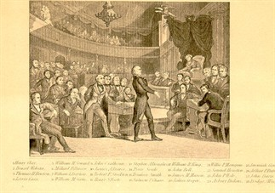
the American System
Post war manufacturing hurt after war with English goods
How do we stop it?
Tariff of 1816
1st ever protective, not revenue
20/25 % protective
Battle in congress

Slide 33
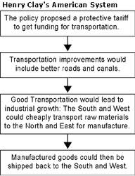
American System
Henry Clay’s idea
1. Bank
2. Protective tariff
3. Internal Improvements
-Revenues for roads and internal improvements from Tariff
-Manufactured goods could get around
People in US agreed: Look at what happened during war

Slide 34
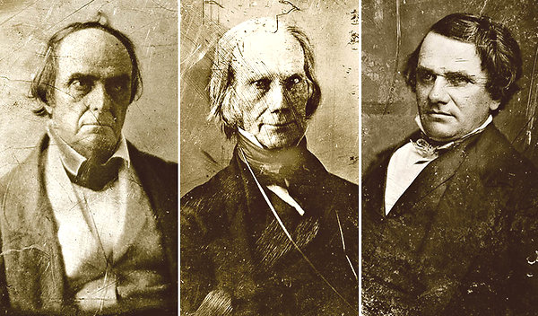
Calhoun(s): war hawk and nationalist
Supported
Later will be against it
Webster (NE)against it
Trading not manufacturing yet
Will flip flop later

Slide 35
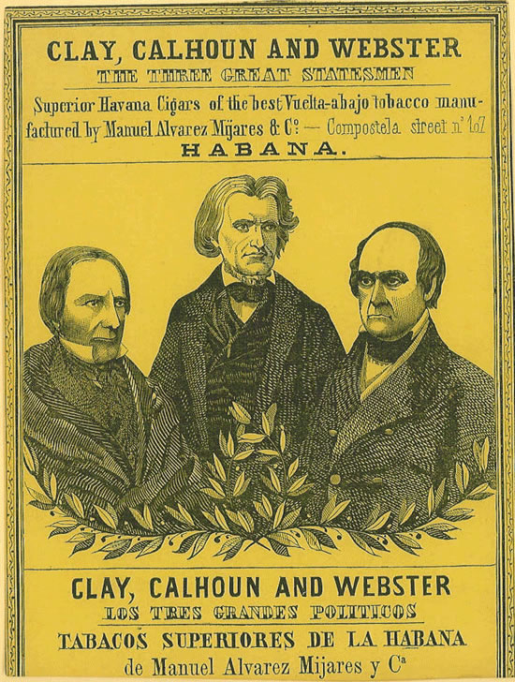
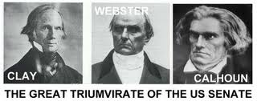
Calhoun tried to keep going through Bonus Bill
Congress passed
Money from bank dividends set aside for internal improvements
Madison vetoed and Monroe followed: Not Fed gov. job
Federalists happy

Slide 36
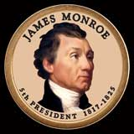
Era of Good Feelings
Monroe comes in next
Virginia dynasty
Last fed. Candidate in this election
Monroe straddled two generations
Level headed, ear to the ground

Slide 37
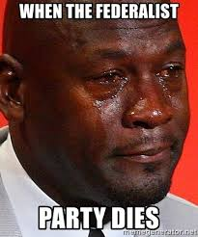
What killed feds?
War record
No nationalistic program

Slide 38
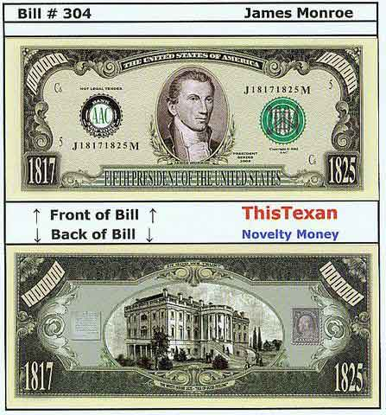
Went on Good Will Tour
Went up into NE and over to Detroit and Niagara
Welcomed everywhere, even in New England
But was era’s name a Misnomer?

Slide 39
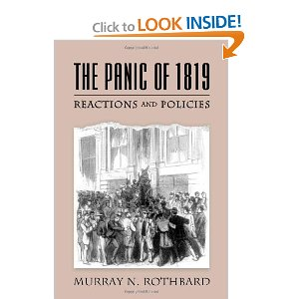
Panic of 1819
1st national panic
Led to sectionalism
West especially hard hit because of wildcat banks
Gave out bad loans and now foreclosing

Slide 40
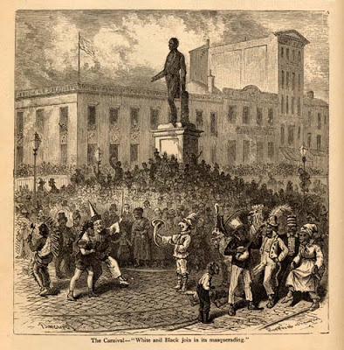
Cause: land speculation
Land act: 1800,04 led to a lot of people buying land, but then hard times, could not pay
Replaced by Land Act of 1820: Less land, but less down so had money to pay monthly

Slide 41
Poorer classes hit worse
Return of debtor prisons, creation of soup kitchens

Slide 42
Growing pains of W
W most nationalistic
No long standing traditions
growing fast
Nine new states
Admitted alternately so state and slave equal
Ohio Fever: Cheap free land
Natives had been moved

Slide 43
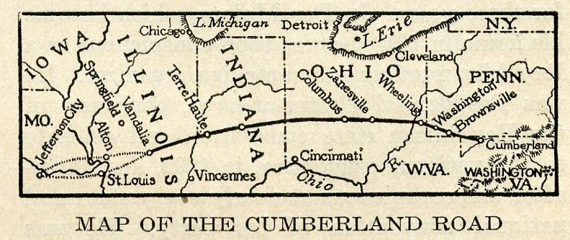
Needed transportation:
Highways: Cumberland
Steamboats
W still had low pop, means low votes
Needed more people to get political influence

Slide 44
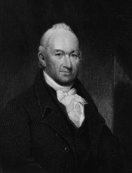
Slavery/Sectional Balance
1819 Missouri wants in
House passed Tallmadge amendment: no more slaves could be brought in to Missouri
Emancipation of children of slaves
Defeated in Senate
Debate continued

Slide 45
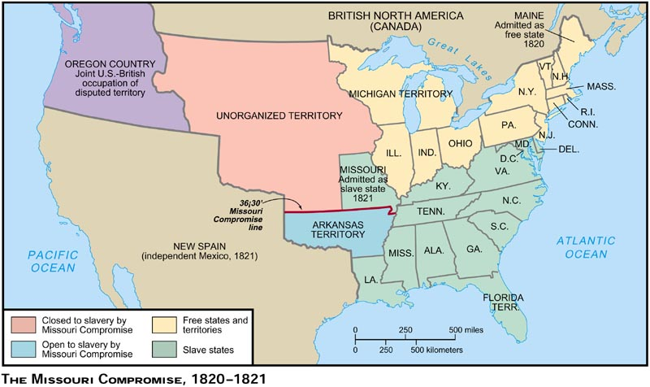
Uneasy Missouri Comp
Clay steps forward
Maine ready to come in
Missouri keep slaves, but everyone north of 36/30 would not have slaves

Slide 46
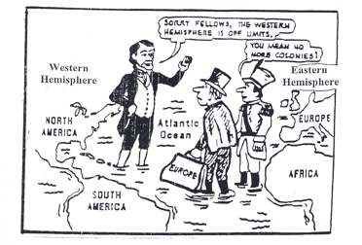
Compromise, get some but not all of what want
34 years
TJ saw the future, it would be war
Created more sectionalism
Both sides mentioned secession
Monroe reelected

Slide 47
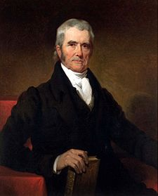
Marshall and Nationalism
Served in Rev. saw what a weak central gov can’t do
SC becomes strong under him
Barely had any schooling
Even TJ’s appointments followed Marshall’s lead

Slide 48
Directions for presenting
Sit with your group in a circle around the room
We need 2 speakers, 2 writers (unless your group only had 3 people) 1 speaker will be the “What”, and the other will be the Significance
Speakers will stand in front and present
Rest of class will write what they say for each case
Then we will look at the big board to formatively assess

Slide 49
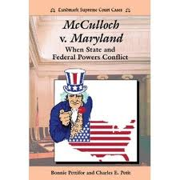
SC curbs states rights
McCulloch v. Maryland 1819
Maryland tries to destroy branch of US bank by taxing it
Marshall said Bank is necessary and therefore falls under implied powers
Reaffirmed the power of the Fed to interpret the constitution

Slide 50
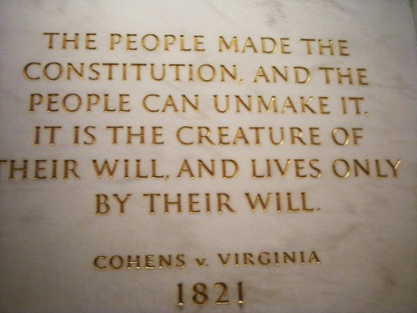
Cohens
Cohens bros selling lottery
VG sues and wins
Goes to SC, and VG wins, but “states” lose
Shows SC can review state decisions and could overturn so has power over states

Slide 51
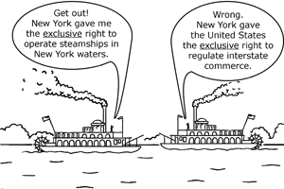
Gibbons: 1824
Steamboat case
NY tried to grant a monopoly to one steamboat company.
Waterway touched more then 1 state
Only Congress can deal with INTERSTATE commerce
Restated the Role of the Federal Government

Slide 52
Judicial Dikes against Democratic excesses
Fletcher v. Peck 1810
Georgia legis. Bribed to give over land in Yazoo River area to speculators
New legislature said it was illegal
Marshall upheld sale because it was contract, and they are legal
Protects Property

Slide 53
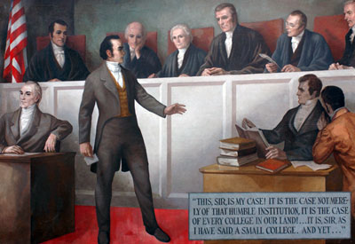
Dartmouth
Dartmouth v. Woodward 1819
Charter by King
NH tried to change
Marshall upheld on the grounds: Charter
FED
over state

Slide 54
Wrap up:
Even though the Federalist party died with the Hartford Convention, how did John Marshall keep alive the basic ideas of the Party?

Slide 55
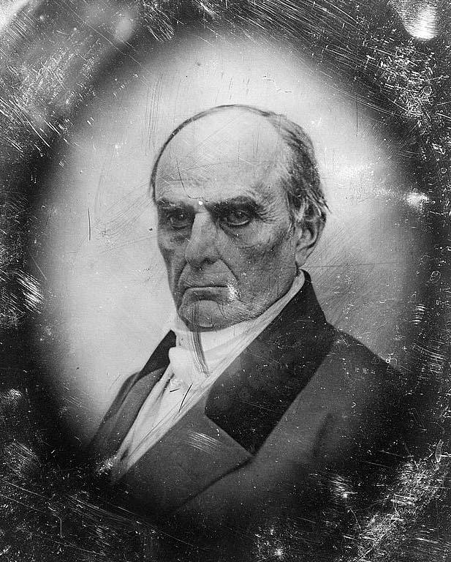
Daniel Webster
Senator, and lawyer
Kept feds going in courts by arguments

Slide 56
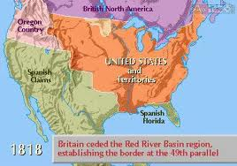
Sharing Oregon and Acquiring FlA
Monroe and JQA (S of S)
Treaty of 1818
-Newfoundland Fisheries
-Set N edge of Lou purchase 49th parallel
-joint occupation of Oregon

Slide 57
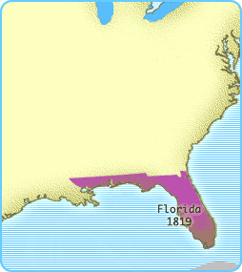
FLA and Adams-Onis
Most of FLA in Spanish hands at end of 1812
Spain suffering through revs in SA
Natives, slaves, and outcasts heading N from FLA
Jackson sent to bring peace and order
AJ took too much power, hanging and slaughtering

Slide 58
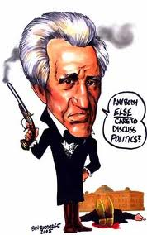
What would Monroe do?
Most said get AJ out of there, but not JQA
Cited Spanish American treaty of 1795 either control or we will
Led to: Fla Purchase Treaty: 1819
FLA and Ore now is US hands

Slide 59
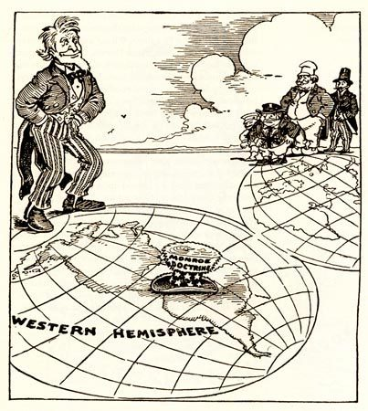
Monarchy in US
Europe monarchs worried: need to stop Democracy
US worried as Kings stop rebellions in Europe
Russia to N in Alaska
As far as S as San Fran
1823 Canning British Foreign Sec. came to US and said we need to protect W. Hem from Europeans

Slide 60
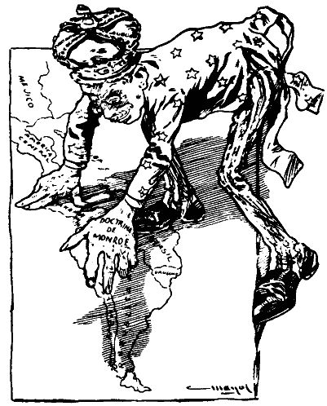
Monroe Doctrine
Many said go with Brits, but not JQA.
he said …Make your stand
We could colonize if not attached to Brits
Europe not ready for US invasion, so we had time
Britain was not going to allow to happen, so would join if needed

Slide 61
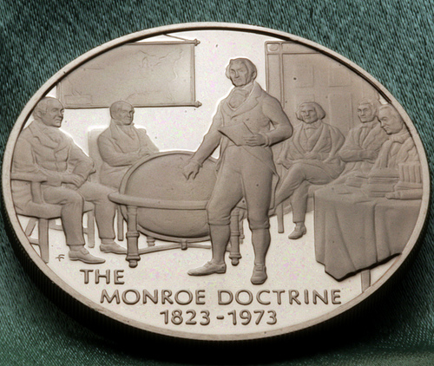
Monroe Doctrine
Non-colonization
Non-intervention
Pointed at Russia first, but meant for everyone
The W Hem was ours

Slide 62
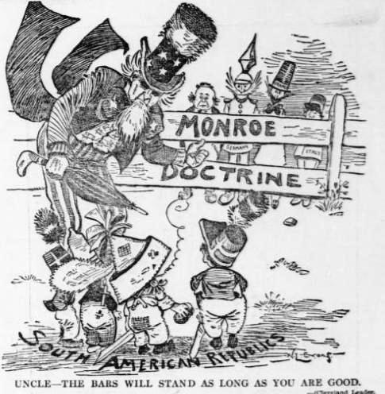

Slide 63
Questions for cartoon
1. Who is on the far side of the fence? What textual clues did you use to figure that out?
2. What tone is Uncle Sam portraying by his facial features?
3. What does the size of the Uncle Sam indicate in relation to the size of the South American Republics?
4. What tone does the bottom caption relay to the reader?
5. How will the Monroe Doctrine help and hurt the US as a burgeoning world power?

Slide 64
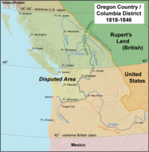
Monroe appraised
Made US proud
Canning irked, but Brit happy overall
Little impact outside of US
Russo American Treaty 1824: set limits of Alaska

Slide 65
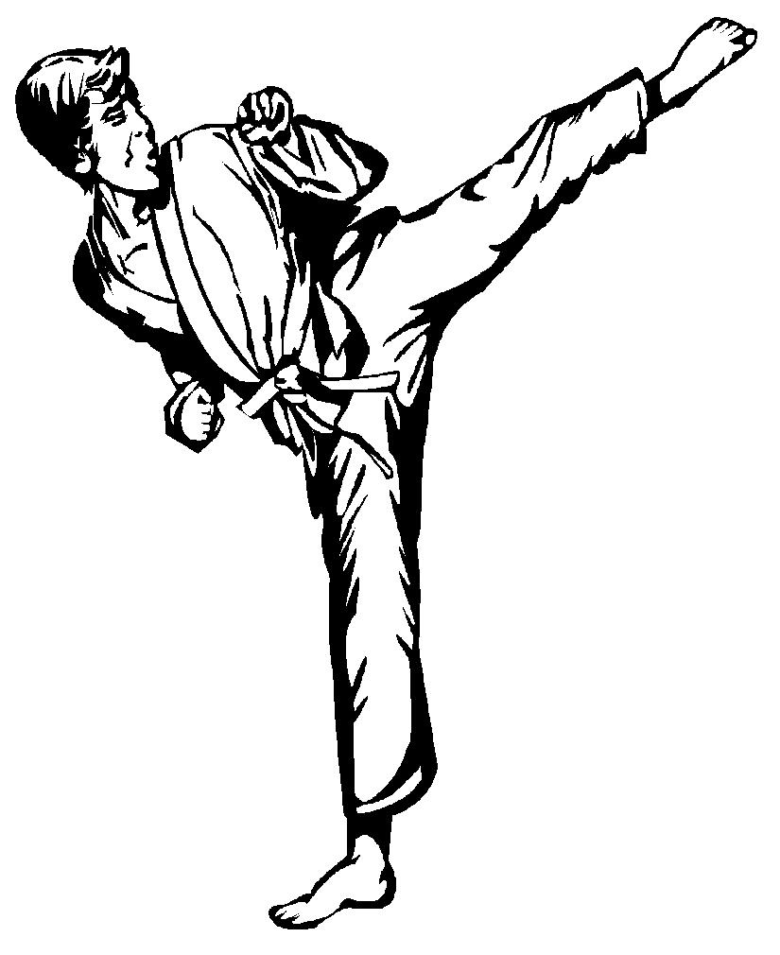
Doctrine appraised
Self Defense Doctrine more then anything
Following trends of earlier pres.
Set trend for future pres

Slide 66
To what extent did the Monroe Doctrine continue the policy of Neutrality started by Washington?
Or
Why was it in England’s best interest to “play along” with the Monroe Doctrine and not challenge it?

Slide 67
Why were the British depicted so differently in the two prints?
What view of themselves would America get from these images?
What do these views suggest about the relative importance of the various causes of the war of 1812?

